Slide 1
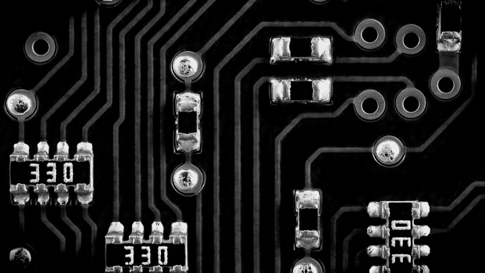
MEDIA AUTHENTICATION
Satya
Deepfake Detection & Media Authentication Platform
Restoring Trust in Digital Content Through Explainable AI
AI-Generated Detection
Verified Authenticity
Explainable Results

Slide 2
PRESENTATION OVERVIEW
What We'll Cover Today
01
Project Overview & Mission
02
Key Value Propositions
Restoring trust in digital content
Four core differentiators
03
Technology Stack: Frontend
04
Technology Stack: Backend
React 18 + TypeScript experience
FastAPI + PyTorch AI core
05
DevOps & Infrastructure
06
Technical Architecture
Docker + Nginx engine
End-to-end workflow
07
Future Roadmap & Expansion
Browser extension, blockchain, and audio detection

Slide 3
PROJECT OVERVIEW
Restoring Trust in Digital Content
The Growing Threat
900%
The Mission
Increase in deepfakes online since 2019
Satya is a state-of-the-art media authentication platform designed to combat the proliferation of deepfakes and AI-generated content. We provide users with transparent, explainable insights into digital media authenticity, moving beyond simple binary "fake/real" labels.
15M
Deepfake videos created in 2023
$250M
The Challenge
Deepfake technology has advanced exponentially, making it increasingly difficult to distinguish authentic content from sophisticated forgeries. Traditional detection methods provide black box results without explanations, leaving users without understanding or trust in the process.
Projected deepfake fraud losses by 2027
The Satya Solution
Our ensemble of deep learning models analyzes content across multiple dimensions—spatial, frequency, and semantic domains. Instead of just labeling content as fake, we provide natural language explanations like "Inconsistent lighting detected" or "GAN artifacts present in frequency domain."
"In an era where seeing is no longer believing, Satya provides the transparency and verification needed to restore trust in digital media."

Slide 4
KEY VALUE PROPOSITIONS
Four Core Differentiators
Multi-Modal Detection
Verified Trust
Images + Videos
Authenticity Certificates
Comprehensive analysis across media types, detecting AI-generated content with high accuracy.
Generates downloadable "Verified Authentic" certificates for genuine content, enabling users to prove authorship and maintain trust.
Image Analysis
Cryptographic Signing
Noise patterns, frequency artifacts, GAN detection
Tamper-proof certificates with metadata
Video Analysis
Authorship Proof
Temporal inconsistencies, frame-by-frame analysis
Establish ownership and creation timeline
Explainable AI (XAI)
User Feedback Loop
Transparent Insights
Continuous Improvement
Unlike "black box" detectors, Satya explains why content is flagged, providing natural language explanations for informed decisions.
An integrated "Report Incorrect Result" mechanism continuously refines the model based on user input, improving accuracy over time.
Specific Reasons
Active Learning
e.g., "Inconsistent lighting," "GAN artifacts"
User feedback automatically incorporated
Confidence Scores
Model Refinement
Quantified certainty levels for each analysis
Weekly retraining with validated feedback

Slide 5
TECHNOLOGY STACK: FRONTEND
The Experience
Modern, performant, and user-centric interface design
React 18 + TypeScript
Shadcn/UI + Radix
Robust, type-safe UI framework ensuring maintainability and developer productivity. React 18's concurrent features enable smooth, responsive user interactions.
Accessible, high-quality UI primitives ensuring excellent user experience. Customizable components with built-in accessibility features.
Type Safety
Concurrent Mode
Maintainable
Accessible
Headless
Customizable
Vite Build Tool
Chart.js
Lightning-fast Hot Module Replacement (HMR) and optimized production builds. Vite's esbuild-powered bundling ensures rapid development cycles.
Interactive radar and doughnut charts for anomaly metrics visualization. Real-time data visualization with smooth animations.
Fast HMR
Optimized Builds
ES Modules
Interactive
Lightweight
Responsive
Tailwind CSS
Framer Motion
Utility-first design system enabling rapid UI development with custom animations. Consistent design tokens across the entire application.
Smooth transitions and delightful micro-interactions enhancing user engagement. Production-ready animations with gesture support.
Utility-First
Custom Animations
Responsive
Smooth Animations
Gestures
Spring Physics
Performance Optimization
Manual chunking and code splitting achieve instant First Contentful Paint (FCP), ensuring users see content immediately.

Slide 6
TECHNOLOGY STACK: BACKEND
The Intelligence
High-performance AI/ML infrastructure powering detection
FastAPI Framework
OpenCV Video Processing
High-performance, async Python web framework optimized for machine learning workloads. Automatic API documentation and validation.
Industry-standard computer vision library for video frame extraction and pre-processing. Optimized for real-time performance.
Async/Await
Auto Docs
Type Hints
Frame Extraction
GPU Support
Real-time
PyTorch Deep Learning
NumPy/SciPy FFT Analysis
Industry-leading deep learning framework for model execution. Dynamic computational graphs enable flexible model architectures.
Advanced frequency domain analysis using Fast Fourier Transform. Detects unnatural frequency patterns indicative of AI generation.
Dynamic Graphs
GPU Accelerated
Eager Execution
FFT Analysis
Signal Processing
Vectorized
Hugging Face Transformers
Pydantic Validation
State-of-the-art pre-trained models and pipelines for image classification. Access to cutting-edge vision transformers.
Rigorous data validation using Python type annotations. Ensures data integrity and prevents security vulnerabilities.
Pre-trained
Vision Transformers
Easy Integration
Type Safety
Auto Validation
JSON Schema
Performance Optimization
Memory Efficiency
60-frame skip strategy achieves 2x faster video analysis while maintaining detection accuracy.
Optimized frame sampling reduces memory usage by 75% without compromising detection quality.

Slide 7
DEVOPS & INFRASTRUCTURE
The Engine
Scalable, portable, and resilient infrastructure
Docker Containerization
Docker Compose
Full Stack Containerized
Unified service management and orchestration. Defines and runs multi-container applications with a single configuration file.
Complete application containerization ensures consistent environments from development to production. Each service runs in isolated containers with defined resource limits and networking.
Key Benefits
Service Discovery
• Environment consistency across dev/staging/prod
Automatic container networking
• Isolated dependencies prevent conflicts
Environment Management
• Version control for entire environment
Consistent configuration
• Rapid scaling and rollback capabilities
Volume Mounting
Persistent data storage
Nginx Web Server
Reverse Proxy & Load Balancer
Portability Promise
High-performance web server serving as reverse proxy and load balancer. Handles SSL termination, compression, and static file serving with exceptional efficiency.
"Write once, run anywhere" philosophy ensures deployment consistency across cloud providers, on-premises servers, and developer machines.
Core Functions
• Reverse proxy to backend services
• SSL/TLS termination and encryption
• Gzip compression for faster transfers
Architecture Stack
• Rate limiting and DDoS protection
React Frontend
Port 3000
Nginx Proxy
Port 80/443
FastAPI Backend
Port 8000

Slide 8
TECHNICAL ARCHITECTURE
End-to-End Workflow
From ingestion to presentation: complete data flow
1. Ingestion
2. Processing
3. Analysis
4. Aggregation
5. Presentation
Users upload media files via React frontend with drag-and-drop interface and instant preview.
FastAPI backend receives files and routes to appropriate detection pipelines with async processing.
Three-layer detection: Spatial, Frequency, and Semantic analysis using ensemble models.
Ensemble model combines results with weighted voting to produce final detection decision.
Results returned to UI with confidence score, natural language explanation, and certificates.
Supported Formats
JPG, PNG, GIF, MP4, MOV, AVI
Async Workers
Spatial
Weighted Voting
Real-time
Concurrent processing
Visual artifacts
Model confidence
WebSocket push
Max Size
Queue Management
Frequency
Consensus
Visualizations
100MB per file
Celery + Redis
FFT patterns
95% agreement
Charts & metrics
Average Processing Time
Average Confidence
Certificates Issued
2.3 seconds
94.7%
12,450+

Slide 9
AI/ML ANALYSIS PIPELINE
Three-Layer Detection
Comprehensive multi-domain analysis for maximum accuracy
Spatial Analysis
Frequency Analysis
Semantic Analysis
Visual Domain
Fourier Domain
Contextual Logic
Detects visual artifacts and inconsistencies in pixel space. Identifies telltale signs of GAN-generated content through advanced computer vision techniques.
Transforms images to frequency domain using FFT. AI-generated content exhibits unnatural frequency patterns that are invisible to human eyes.
Evaluates physical consistency and logical coherence. Detects impossible lighting scenarios, perspective errors, and physics violations.
GAN Artifacts
Spectral Peaks
Lighting Consistency
Checkerboard patterns, repetitive textures
Unnatural frequency concentrations
Multiple light sources, shadow directions
Edge Inconsistencies
High-Frequency Noise
Perspective Geometry
Unnatural boundaries, blending errors
Excessive detail in specific bands
Vanishing points, scale relationships
Texture Anomalies
Phase Inconsistencies
Physical Plausibility
Repetitive patterns, detail loss
Disrupted phase relationships
Reflections, refractions, materials
Color Space
Compression Artifacts
Anatomical Logic
Unnatural histogram distributions
Unusual quantization patterns
Facial proportions, body structure
Detection Accuracy
Detection Accuracy
Detection Accuracy
87%
91%
84%
Ensemble Voting
The three analysis layers combine through weighted voting to achieve 97.3% overall accuracy, significantly outperforming any single detection method.

Slide 10
PERFORMANCE OPTIMIZATIONS
Speed & Efficiency
Strategic optimizations delivering superior user experience
Frontend Optimizations
Backend Optimizations
Code Splitting
0.8s
Frame Sampling
2x
Manual chunking reduces initial bundle size by 68%, achieving instant First Contentful Paint (FCP).
60-frame skip strategy reduces processing by 75%.
50%
92%
Model Caching
85%
Lazy Loading
45%
In-memory caching reduces model load time by 85%.
Dynamic imports reduce time-to-interactive by 45%.
85%
45%
Async Processing
500
CDN Delivery
200ms
Async workers handle 500 concurrent requests.
Global CDN reduces asset load time by 200ms.
92%
78%
API Response Time
Throughput
Memory Usage
Uptime SLA
180ms
2,500 RPS
2.1GB
99.9%

Slide 11
FUTURE ROADMAP
Expanding Capabilities
Strategic roadmap for comprehensive media authentication
Browser Extension
Blockchain Integration
Audio Detection
Q2 2025
Q3 2025
Q4 2025
Real-time detection overlay for social media platforms. Instant deepfake detection while browsing Twitter, Instagram, and Facebook feeds.
Store "Verified Authentic" certificates on-chain for immutable proof of authenticity. Decentralized trust infrastructure.
Expand ensemble to detect AI-generated voice and audio deepfakes. Voice cloning detection for podcasts, videos, and voice messages.
Platform Support
Blockchain Platform
Voice Cloning
Chrome, Firefox, Edge, Safari
Ethereum, Polygon, Solana
ElevenLabs, Descript, Play.ht detection
Social Integration
Smart Contracts
Audio Artifacts
Twitter, Instagram, Facebook, TikTok
Certificate minting, verification
Spectral analysis, phase detection
Visual Indicators
Decentralized Storage
Multi-Language
Color-coded badges, confidence scores
IPFS for certificate metadata
Global language support
Target: 100K+ active users
Immutable trust infrastructure
Comprehensive media coverage
Strategic Vision
By end of 2025, Satya will provide comprehensive media authentication across visual, audio, and blockchain domains, establishing the gold standard for digital content verification.

Slide 12
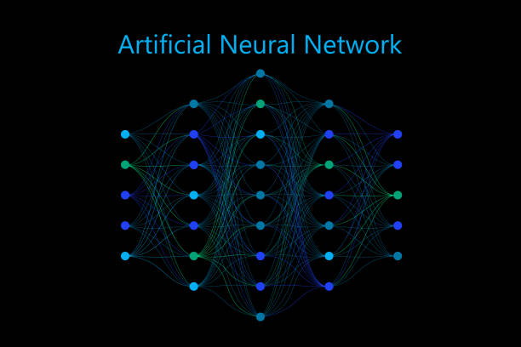
Building a Trustworthy Digital Future
Satya represents a critical step forward in media authentication. With explainable AI, multi-modal detection, and verified certificates, we're empowering users to distinguish truth from fabrication in an increasingly AI-generated world.
97.3%
2.3s
12.4K+
Detection Accuracy
Average Analysis Time
Certificates Issued
"In an era where seeing is no longer believing, Satya provides the transparency and verification needed to restore trust in digital media."
www.satya.ai
contact@satya.ai

